Slide 1
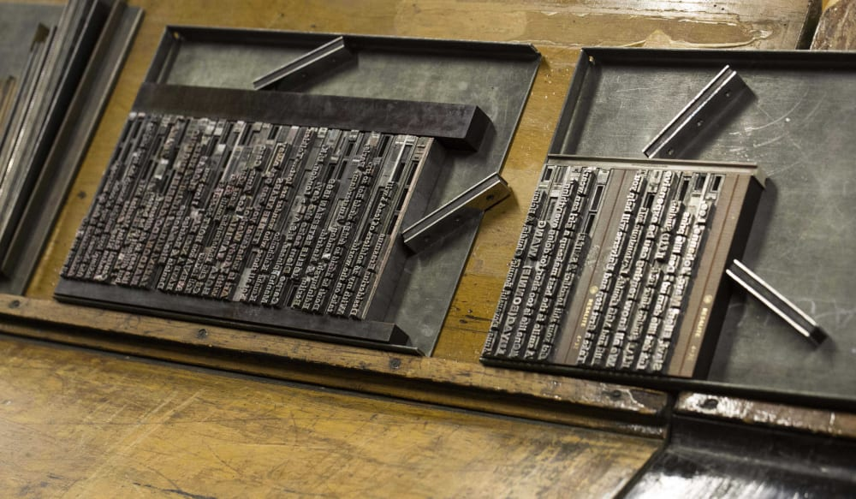
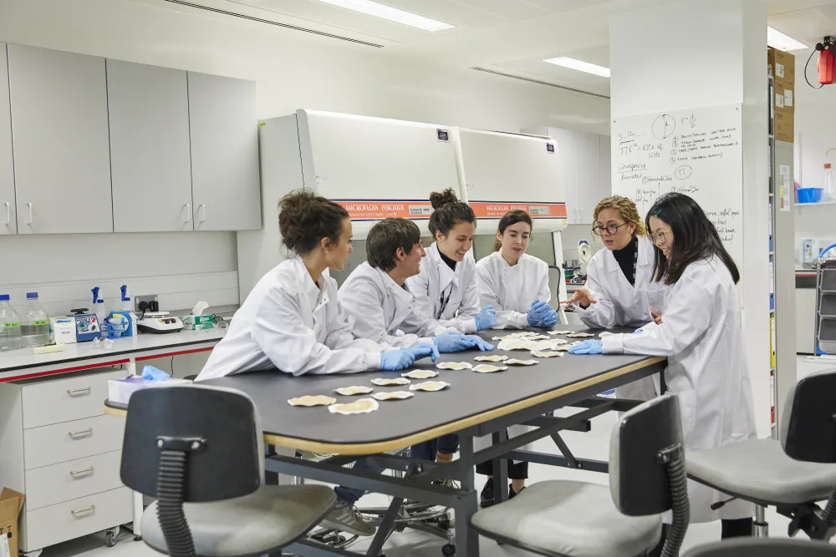
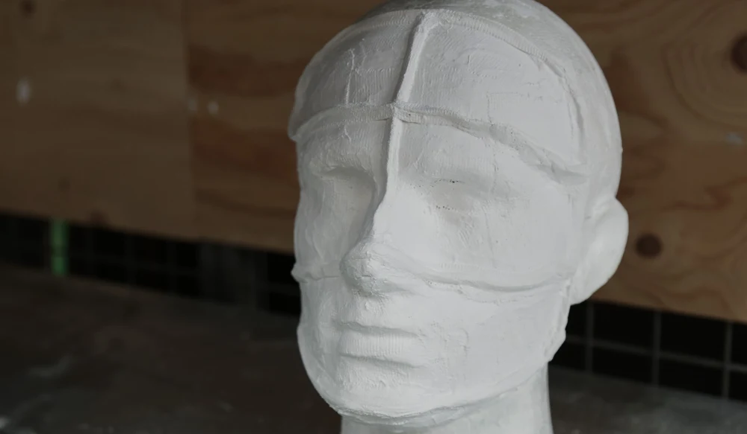
Nina O'Reilly, Specialist Technician – Digital Projects (CSM)

Slide 3
Dare, E. (2018) 'Out of the humanist matrix: Learning taxonomies beyond Bloom', Spark: UAL Creative Teaching and Learning Journal, 3(1), pp. 43-51.
Abstract
This article critiques the ‘humanist’ legacy by questioning the cognitivist and constructivist paradigms which underpin dominant models of adult learning. It asks whether they are suitable for evaluating the way art and design students work with digital technology, questioning humanist and cognitivist models of learning, such as Bloom’s Cognitive Taxonomy (Bloom et al., 1956) and whether it supports curiosity, criticality and imaginative risk. It connects this issue to the problem of ‘normative validity’, which describes how that which is measured is valued – ‘the indicator of quality becomes the definition of quality’ (Biesta, 2013, p.1) – overshadowing more inclusive approaches to learning.

Slide 4
Why I chose this
Humanist pedagogical theories have underpinned the approaches of many institutions I have worked in, including publishing companies and higher education institutions.
I have encountered this "escalating culture of ‘accountability and audit,'"(p.47) across institutions and have watched it increasingly manifest itself in how teaching and learning is understood and approached.
I remember designing learning content for particular company that gave a score for the range of Bloom's taxonomy verbs in use!
It sometimes feels as though, provided one designs within the lines of humanist pedagogies, all learners and their learning can be uniformly captured and contained within the same approach.
This article reassuringly argues against this.

Slide 5
What I learnt from this
Humanist pedagogical approaches have developed with a white male Eurocentric view on the human experience. Additionally, assumptions are made that humans think, feel and behave in the same way.
"Are the hard-and-fast metrics which educators and technologists find themselves bombarded with in any way reconcilable with an evaluation of what happens when students engage with creative practice? Practices in which ‘the kinds of transitions we are considering are not linear, not the learning of simple isolated concepts’ but ‘messy, abstract transformations’?" (p.47)
Posthumanist pedagogical approaches decenter the "human" and level the inherited boundaries between objects and subjects, humans, animals and machines.
I reflected on my own practice as a learning technologist:
What I have been trained to do
The systems in use – Moodle was created by an avowed Constructivist
What now?

