Slide 1
How to make more sustainable elearning content
ual:

Slide 2
How to play this game
This game can be played in groups or on an individual basis.
All you need to do is turn on the presentation slide show and click the screen to follow through the game.
Hopefully you will enjoy and learn something along the way!

Slide 3
Welcome
Question Time
If the internet were a country, it would be one of the world’s top ten polluters.
In this game you will learn about how to make online learning content more sustainable.
We often don’t think of the internet as a contributing factor to climate change. However, the sheer amount of (not always renewable) energy used to power the internet as well as data centres and networks has a large carbon cost.
As online learning is a vital part of teaching and learning at UAL, this game will show you some simple steps you can follow to make your online learning content more sustainable.
But first, let’s do a quick true/false question!
True
False
Different studies have placed it 7th, 6th, and even 4th, depending on how they defined the internet.
START GAME

Slide 4
10 tips for more sustainable elearning content
Select each tip as they become available
Tip 1
Watch the carbon counter reduce as the game progresses!
Carbon counter

Slide 5
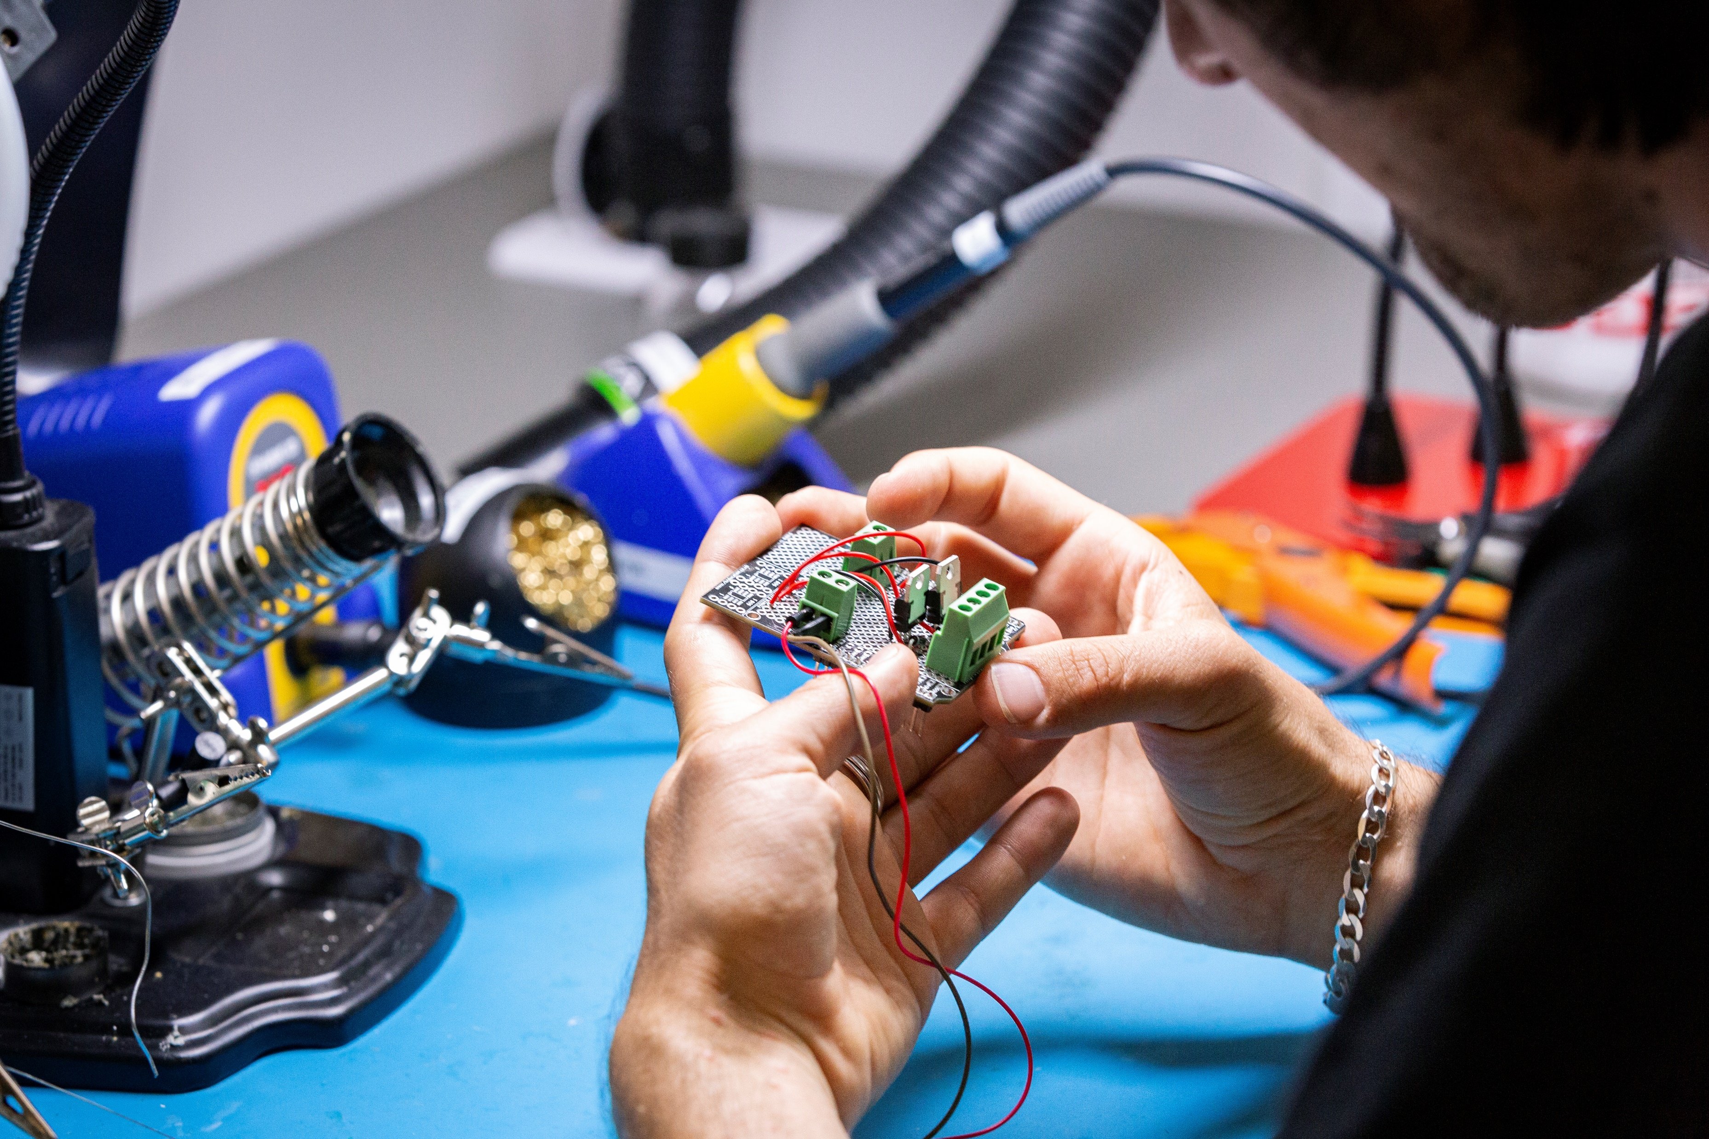
Tip 1: Images
Question time
Which image below is the original and which is compressed?
Images tend to be responsible for the largest over-the-wire transfer rates. So doing all you can to reduce them, their size, and loading will be beneficial for sustainability!
What you can do:
Assess the need for images, remove any that you can.
Compress those you can’t remove. This reduces the size but not the quality of the image.
There are a range of free image compression sites available online.
Compressed
ORIGINAL

Slide 6
10 tips for more sustainable elearning content
Tip 1:
Images
Tip 2: Language
Carbon counter

Slide 7
Tip 2: Language
Try it yourself:
Hemingway Editor is an online tool that assesses the complexity of written text.
Find some written elearning content – a unit guide, assessment description, etc – and run it through the editor.
What is your score?
Everyone should be able to understand what you've written without wasting time staring at a screen or jumping from page-to-page looking for answers.
What you can do:
Write clearly using plain, inclusive language delivered at an easy-to-understand reading level
Avoid jargon/ technical language without explanations
Use clear document structure, visual hierarchy, headings, bulleted lists, line spacing, and so on.

Slide 8
10 tips for more sustainable elearning content
Tip 1:
Images
Tip 2: Language
Tip 2: Documents
Carbon counter

Slide 9
Tip 3: Documents
Question time:
You are designing and sharing a unit brief for a course. Which of the following are good options to make this content sustainable?
Using lots of photographs and visuals to get your point across
Upload it to Moodle
Email it to all the students and ask them to bring a printed copy to the first taught session
Printing documents and downloading files both have costs in terms of sustainability, as they use up paper, ink, and energy. It’s therefore a good idea to optimise documents for printing and download.
Not great for printing or for the size of the file download!
Yes, students can access it as and when they need. Make sure it’s clearly labelled so students know what they’re downloading. Also, set it to open in browser rather than a forced download to their machine
There’s a carbon cost to emailing and printing, especially if you have a large cohort! Better to make it available on Moodle and students can choose how they use it.

Slide 10
10 tips for more sustainable elearning content
Tip 1:
Images
Tip 2: Language
Tip 4: Duplicate Data
Tip 3: Documents
Carbon counter

Slide 11
Tip 4: Duplicate data
Question Time
Data storage accounts for more carbon emissions than the commercial airline industry.
It’s obviously sensible to keep a back-up of content, whether that’s a unit brief or a back-up of an entire Moodle course. However, the more back-ups and duplicated data the more energy expended to store that data, especially on the cloud.
What you can do:
Keep an up-to-date overview of your backed up data.
Are you storing the same thing multiple times/in multiple locations?
Is some of the content superseded?
Stop storing anything you no longer need.
True
False
Unfortunately, this is true!
Check out this article from the World Economic Forum to learn more.

Slide 12
10 tips for more sustainable elearning content
Tip 1:
Images
Tip 2: Language
Tip 3: Documents
Tip 4: Duplicate Data
Tip 5: Ideation
Carbon counter

Slide 13
Tip 5: Ideation
Try it yourself:
If you’re new to wireframing, prototyping and user testing LinkedIn Learning has lots of learning resources to get you started.
If you are creating a new resource, ie a new Moodle course, a blog site etc. It can save energy to ideate, wireframe and test your ideas with users before building the full-blown finished product.
What you can do:
You could consider wireframing or rapid prototyping (using paper) among but even the electronic versions have a lower carbon cost than committing to building a full-blown experience for each idea.
Involve your students within the iteration and design process. This means time and effort will go into developing a resource that works for them, the end user.

Slide 14
10 tips for more sustainable elearning content
Tip 1:
Images
Tip 2: Language
Tip 3: Documents
Tip 4: Duplicate Data
Tip 5: Ideation
Tip 6: Navigation
Carbon counter

Slide 15
Tip 6: Navigation
Try it yourself:
Think about the student experience of your elearning resource, or better yet talk to them about it. You can uncover existing problems and ensure wayfinding is working for them.
Efficient and intuitive navigation means students spend less time and energy finding what they require and accomplishing tasks. This also lowers emissions helps to reduce data wastage.

Slide 16
10 tips for more sustainable elearning content
Tip 1:
Images
Tip 2: Language
Tip 3: Documents
Tip 4: Duplicate Data
Tip 5: Ideation
Tip 6: Navigation
Tip 7: Consistency
Carbon counter

Slide 17
Tip 7: Consistency
Try it yourself:
How consistent are Moodle pages, submission points, other learning resources across a programme you work with?
Is there much variance from unit to unit? How might you go about unifying things if not?
To aid ease of navigation (Tip 6), use consistent layouts and designs across your elearning content. Using easily recognized design components will reduce the amount of time visitors spend browsing between pages, trying to identify the information they came to your resource to locate. As such, the less time visitors spend on your site, the greater the efficiency savings in terms of emissions.
Benefits:
Accessibility: Recognizable design patterns can help people with cognitive disabilities easily understand how to perform a task. Similarly, simple layouts often improve access to information as well.
Performance: Using recognized patterns which appear where visitors expect, and only when they require them may increase the perceived speed of the website or application as navigation from point-to-point will increase due to the ease of use.

Slide 18
10 tips for more sustainable elearning content
Tip 1:
Images
Tip 2: Language
Tip 3: Documents
Tip 4: Duplicate Data
Tip 5: Ideation
Tip 6: Navigation
Tip 7: Consistency
Tip 8: User attention
Carbon counter

Slide 19
Tip 8: User attention
Question time
Thinking about your Moodle course, Sharepoint page, Teams site, etc. which of these options best respect your students’ attentions? Why?
Having all course materials on a single, continuously scrolling page for a seamless experience.
Organising course materials into sections with clear headings, allowing students to navigate directly to the information they need.
It’s an age-old challenge: how do we include all the important information a student needs without overwhelming them and forcing them to trawl through it all to find the things they need? This trawling is not only frustrating, it means more time and energy is also wasted.
Benefits:
Accessibility: Recognizable design patterns can help people with cognitive disabilities easily understand how to perform a task. Similarly, simple layouts often improve access to information as well.
Performance: Using recognized patterns which appear where visitors expect, and only when they require them may increase the perceived speed of the website or application as navigation from point-to-point will increase due to the ease of use.

Slide 20
10 tips for more sustainable elearning content
Tip 1:
Images
Tip 2: Language
Tip 3: Documents
Tip 4: Duplicate Data
Tip 5: Ideation
Tip 6: Navigation
Tip 7: Consistency
Tip 8: User attention
Tip 9:
Mobile responsive
Carbon counter

Slide 21
Tip 9: Mobile responsive
Question Time
Smartphones are the most commonly used device by UK HE students for learning.
Have you ever encountered a website that clearly wasn’t designed for mobile? The experience is not only frustrating but bad for the environment! All the more reason to check out your elearning resources in mobile as well as desktop view.
Benefits of responsive design
Energy usage is reduced in well performing sites and when users have streamlined experiences.
Smaller devices are often use less energy.
Social equity: not everyone may have a laptop but they will more than likely have a phone.
Flexibility of access, students can access content on their choice of device and when on the move.
True
False
False! According to a Jisc survey 93% of university students use laptops for learning, however smartphones are also used by 63%. In addition, most students use two devices for learning.

Slide 22
10 tips for more sustainable elearning content
Tip 1:
Images
Tip 2: Language
Tip 3: Documents
Tip 4: Duplicate Data
Tip 5: Ideation
Tip 6: Navigation
Tip 7: Consistency
Tip 9:
Mobile responsive
Carbon counter
Tip 8: User attention
Tip 10:
Necessity

Slide 23
Tip 10: Necessity
Question time:
Sometimes it may seem easier to make everything yourself… but ask yourself which option really seems best?
Independently creating all the materials you need for your project without consulting colleagues.
Proactively connecting with colleagues and networks to share resources, ideas, and collaborate on content creation to avoid duplicating efforts.
The most existential of all the tips: is your elearning content or service really necessary?
Okay, maybe some aspects are non-negotiable, ie the unit’s Moodle page or whatever your online learning space is.
But do you need to create bespoke content for everything? What pre-existing videos, PDFs, blog posts etc are out there that you can you link to or reuse?
Don’t waste digital space, time and resources on something that doesn’t need to be made.

Slide 24
10 tips for more sustainable elearning content
To learn more about these tips, or web sustainability more broadly please see the Web Sustainability Guidelines.
YOU’VE UNCOVERED ALL THE TIPS AND CARBON COUNT IS AT ZERO!
Tip 1:
Images
Tip 2: Language
Tip 3: Documents
Tip 4: Duplicate Data
Tip 5: Ideation
Tip 6: Navigation
Tip 7: Consistency
Share this game with colleagues!
Tip 9:
Mobile responsive
Carbon counter
Tip 8: User attention
Tip 10:
Necessity

