Slide 1
Digital sustainability: awareness and best practice of UAL digital learning staff
Nina O’Reilly | Action Research Project presentation

Slide 2
Original context/background
My role: online learning
Social justice area = climate justice
digital sustainability for elearning content and sites
Notes:
Explain what digital sustainability is in my context.

Slide 3
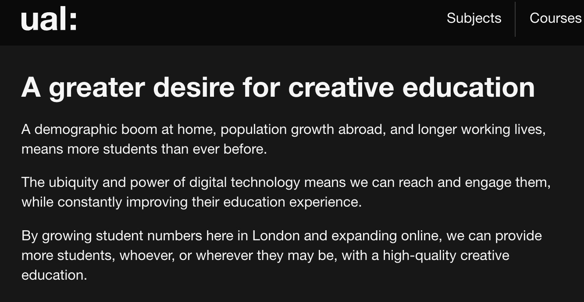
Rationale for selecting topic
Scan me to read more on my blog!
Why is this important:
90%
The percentage of students who said climate change impacted their mental health and wellbeing in the preceding four weeks.
Climate Change and Student Mental Health Report 2023
>
Notes:
Climate crisis > the internet’s role in this
UAL strategy (for online learning & climate)
Student anxiety

Slide 4
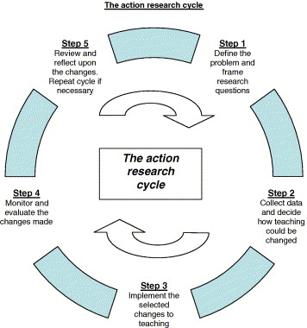
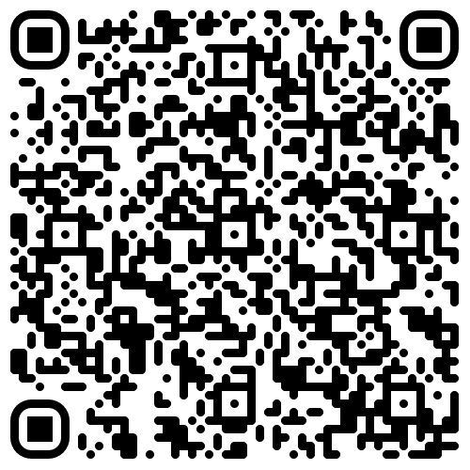
Research questions & ARP cycle
How aware are UAL digital learning staff members about digital sustainability?
How can knowledge and confidence of this topic be increased to create best practice?
Scan me to read more on my blog!
Notes:
Mention how I am starting out with this topic, so the questions are foundational and this is where I am on the action research cycle

Slide 5
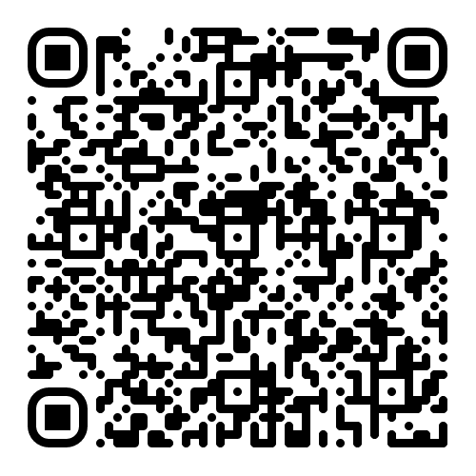
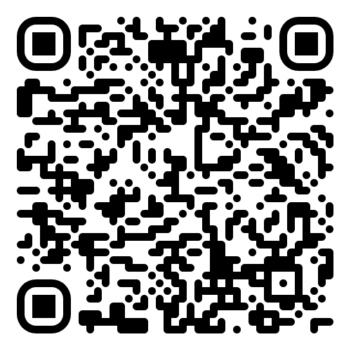
Reflection on research methods
Online questionnaire of UAL learning technologists
Pew Research Center (2021) Writing survey questions. Available at: https://www.pewresearch.org/our-methods/u-s-surveys/writing-survey-questions/ (Accessed: 05 December 2023).
Document analysis of the Web Sustainability Guidelines
Bowen, G.A. (2009) ‘Document analysis as a qualitative research method’, Qualitative Research Journal, 9(2), pp. 27–40. doi:10.3316/qrj0902027.
Training: ual carbon literacy
Scan me to read more about my research methods.
Scan me to read more about my ethical concerns.
Notes:
Document analysis of the Web Sustainability Guidelines: 1st draft newly released by the World Wide Web Consortium which is the standards body for all things online. Analysed this to see what where we could begin at UAL. But I knew from my reading of Bowen, that as a research method this does not provide sufficient detail, nor would it answer my research questions fully.
Questionnaire of UAL learning technologists: In my ethics form I thought about the potential sensitivity of this topic. I chose an online anonymous questionnaire to allow participants to speak freely an honestly about their knowledge and practice with this topic. Questionnaire formulated in conjunction with the Pew Research Centre’s guide.
Training: ual carbon literacy, learning about the topic but observing how a sensitive topic can be taught and engaged with.

Slide 6
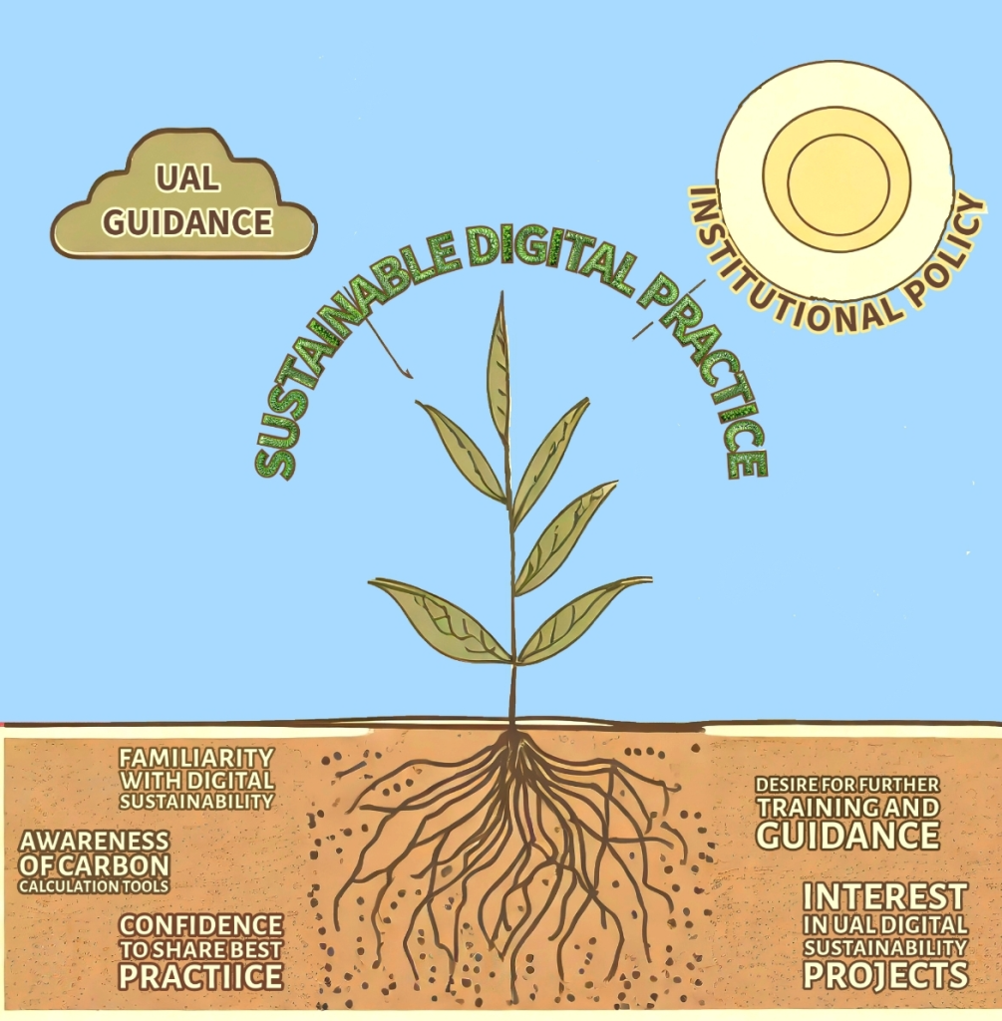
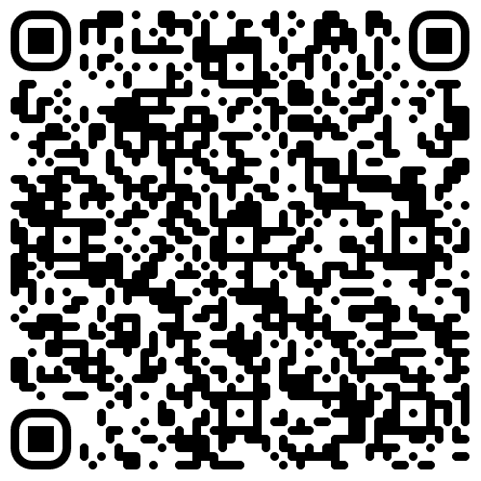
Questionnaire findings
36% response rate (14 of 39)
Thematic analysis
Braun, V. and Clarke, V. (no date) Doing reflexive Thematic Analysis. Available at: https://www.thematicanalysis.net/doing-reflexive-ta/ (Accessed: 23 November 2023).
64% unconfident about sharing best practice for digital sustainability
92% interested in training and guidance on this topic
Scan me to read about questionnaire findings.
Notes:
Questionnaire: mention some of the stats.

Slide 7
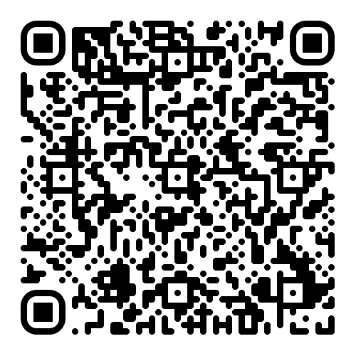
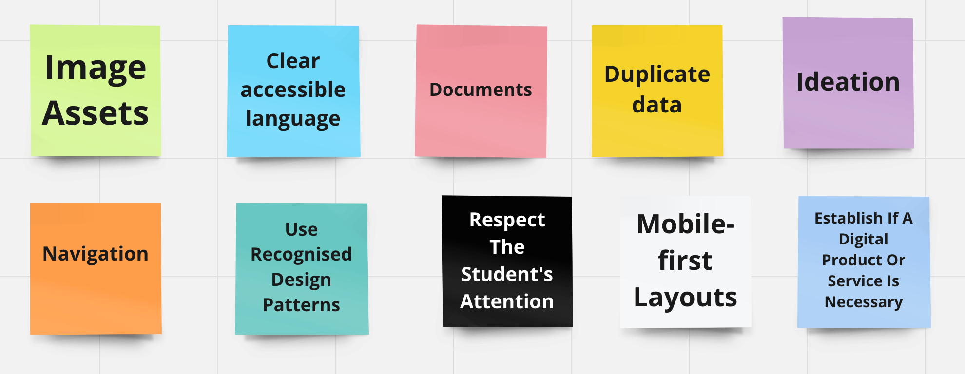
Document analysis findings
Scan me to read about document analysis findings.
Document analysis of the Web Sustainability Guidelines
Notes:
Document analysis: From Nearly 100 guidelines for making websites and digital products more sustainable I whittled it down to 10 actions that our digital learning teams could be aware of to make their online learning materials and sites more sustainable. Each guideline is designated as low

Slide 8
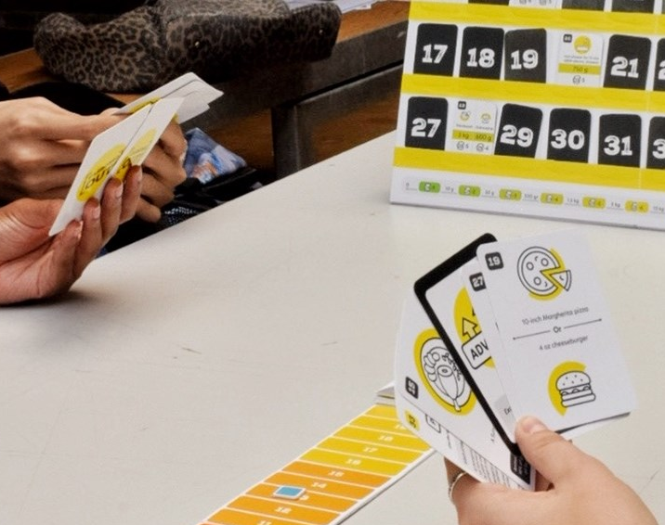
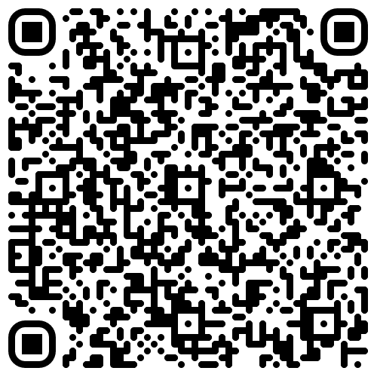
Carbon Literacy Training findings
Carboned Out! game by former UAL students
Exploring gamification for my intervention
Landers, R.N., Auer, E.M., Helms, A.B., Marin, S. and Armstrong, M.B., 2019. Gamification of adult learning: Gamifying employee training and development. The Cambridge handbook of technology and employee behavior, pp.271-295.
Scan me to read more on my blog!
Notes:
Carbon literacy training: I found about carbon, about the UAL context but most importantly I observed pedagogically how to engage learners with this topic without overwhelming them: through gamification. Former UAL students created a game called Carboned Out to help learn the carbon cost of different activities. Observing this encouraged my reading about gamification and its application in helping digital learning teams change their practice.

Slide 9
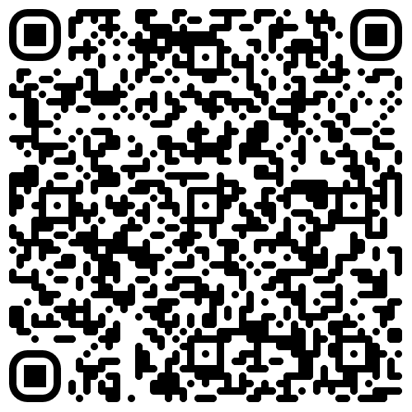
Intervention
Scan me to read more on my blog!
Notes:
Prototype of a game I have created (show a slide or two?) test it with peers and speak with the central UAL team about sharing the practice

Slide 10
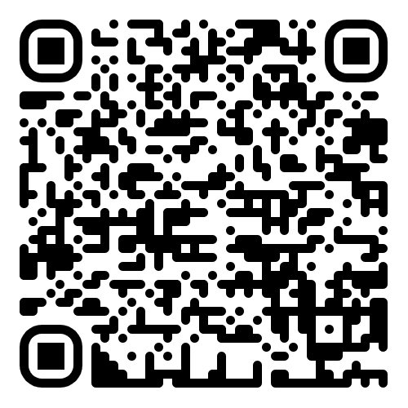
Reflections
How aware are UAL digital learning staff members about digital sustainability?
How can knowledge and confidence of this topic be increased to create best practice?
Scan me to read more on my blog!
Notes:
Mention how I am starting out with this topic, so the questions are foundational and this is where I am on the action research cycle

Slide 11
References 1/2
Barker, G. (2023) UAL Carbon Calculation: Educational Working Group. Available at: https://canvas.arts.ac.uk/News/240267/ual-carbon-calculation-educational-working-group. (Accessed 12 January 2024)
Berners-Lee, M (2020). How bad are bananas? : the carbon footprint of everything. London: Profile Books.
Bowen, G.A. (2009) ‘Document analysis as a qualitative research method’, Qualitative Research Journal, 9(2), pp. 27–40. doi:10.3316/qrj0902027.
Braun, V. and Clarke, V. (no date) Doing reflexive Thematic Analysis. Available at: https://www.thematicanalysis.net/doing-reflexive-ta/ (Accessed: 23 November 2023).
British Educational Research Association (2018) Ethical Guidelines for Educational Research. 4th ed. Available at: https://www.bera.ac.uk/publication/ethical-guidelines-for-educational-research-2018 (Accessed 25 October 2023)
Dawson, A. and Frick, T. (eds.) (2023) Web Sustainability Guidelines (WSG) 1.0, Web sustainability guidelines (WSG) 1.0. Available at: https://w3c.github.io/sustyweb/ (Accessed: 09 October 2023).
Daeninck, C., Kioupi, V. and Vercammen, A. (2023) ‘Climate anxiety, coping strategies and planning for the future in environmental degree students in the UK’, Frontiers in Psychology, 14. doi:10.3389/fpsyg.2023.1126031.
Ecograder.com (2023) Impact report for https://www.arts.ac.uk/. [Webpage] Available at: https://ecograder.com/report/rnbx0SlRapy8Ax39sXAtbVRR (Accessed: 06 October 2023).
Ecograder.com (2023) Impact report for https://moodle.arts.ac.uk/login/index.php. [Webpage] Available at: https://ecograder.com/report/orCS0jpIHGiJjy8Ddp51yvnw (Accessed: 06 October 2023).
Ellis, C.S. and Bochner, A.P. (2006) ‘Analyzing analytic autoethnography’, Journal of Contemporary Ethnography, 35(4), pp. 429–449. doi:10.1177/0891241606286979.
Gibbs G (1988). Learning by Doing: A guide to teaching and learning methods. Oxford Polytechnic: Oxford.
GreenNet (2023) Understanding file sizes. Available at: https://www.greennet.org.uk/support/understanding-file-sizes (Accessed 22 January 2024).
Greenwood, T. (2023) 20 ways to make your website more energy efficient, Wholegrain Digital. Available at: https://www.wholegraindigital.com/blog/website-energy-efficiency/ (Accessed: 09 October 2023).
Griffiths, S. (2022) Why your internet habits are not as clean as you think, BBC Future. Available at: https://www.bbc.com/future/article/20200305-why-your-internet-habits-are-not-as-clean-as-you-think#:~:text=The%20carbon%20footprint%20of%20our,a%20researcher%20at%20Lancaster%20University. (Accessed: 06 October 2023).
Heselden, M. (2022) Digital content design strategy for arts.ac.uk 2022-2025. Available at: https://canvas.arts.ac.uk/documents/sppreview/0eb0ce28-2598-47c4-b672-787b3f906f97 (Accessed: 19 October 2023).
Jackson, T. and Hodgkinson, I.R. (2022) What is ‘dark data’ and how is it adding to all of our carbon footprints?, World Economic Forum. Available at: https://www.weforum.org/agenda/2022/10/dark-data-is-killing-the-planet-we-need-digital-decarbonisation/?utm_campaign=social_video_2022 (Accessed: 25 January 2024).
Jisc (2022) Student digital experience insights survey 2021/22 UK higher education (HE) survey findings. Available at: https://repository.jisc.ac.uk/8850/1/2022-07%20%28iDFltdP024.11%29%20DEI%20HE%20%26%20FE%20Reports%202022%20%28HE%29%20v1-05.pdf (Accessed 25 January 2024).
Joyce, E. (2023) All staff briefings Q&A session | Monday 16 October Available at: https://canvas.arts.ac.uk/documents/sppreview/e2818b82-6dc5-448e-8c73-1669759abea9 (Accessed 25 January 2024).

Slide 12
References 2/2
Landers, R.N., Auer, E.M., Helms, A.B., Marin, S. and Armstrong, M.B., (2019) Gamification of adult learning: Gamifying employee training and development. The Cambridge handbook of technology and employee behavior, pp.271-295.
Mansoux, A. et al. (2023) ‘Permacomputing Aesthetics: Potential and Limits of Constraints in Computational Art, Design and Culture’, in Ninth Computing within Limits 2023. LIMITS. doi:10.21428/bf6fb269.6690fc2e
McNiff, J. (2020) ‘Action Research for Professional Development’ [electronic resource]. https://www.jeanmcniff.com/ar-booklet.asp (Accessed 20 November 2023)
Odrozek, K. (2018) The internet uses more electricity than…, Internet Health Report. Available at: https://internethealthreport.org/2018/the-internet-uses-more-electricity-than/ (Accessed: 06 October 2023).
Permacomputing.org (2023) Permacomputing. Available at: https://permacomputing.net/ (Accessed 06 October 2023).
Paisey, C. and Paisey, N.J. (2005) ‘Improving accounting education through the use of action research’, Journal of Accounting Education, 23(1), pp. 1–19. doi:10.1016/j.jaccedu.2004.10.001.
Pew Research Center (2021) Writing survey questions. Available at: https://www.pewresearch.org/our-methods/u-s-surveys/writing-survey-questions/ (Accessed: 05 December 2023).
Qualtrics (2023) Survey Methodology & Compliance Best Practices: Predicted Duration, Qualtrics XM: The Leading Experience Management Software. Available at: https://www.qualtrics.com/support/survey-platform/survey-module/survey-checker/survey-methodology-compliance-best-practices/?utm_medium=ExpertReview&utm_source=product&utm_campaign=PredictedDuration&utm_content=#PredictedDuration (Accessed: 20 November 2023).
Siegman, T. (2023) Introducing web sustainability guidelines, W3C. Available at: https://www.w3.org/blog/2023/introducing-web-sustainability-guidelines/ (Accessed 09 October 2023).
Smith, A. (2023) Climate Change and Student Mental Health Report. Available at: https://www.studentminds.org.uk/uploads/3/7/8/4/3784584/climate_change_and_student_mental_health.pdf (Accessed 25 January 2024)
University of Edinburgh (2020) Gibbs’ Reflective Cycle. Available at: https://www.ed.ac.uk/reflection/reflectors-toolkit/reflecting-on-experience/gibbs-reflective-cycle (Accessed 25 January 2024).
University of Sheffield. (2018) Emotionally demanding research: risks to the researcher. [Specialist Research Ethics Guidance Paper]. Available via: https://moodle.arts.ac.uk/pluginfile.php/1587855/mod_folder/content/0/SREGP-Emotionally-Demanding-Research%20-%20University%20of%20Sheffield%202018.pdf?forcedownload=1 (Accessed 25 October 2023)
University of the Arts London (2023) Electricity Consumption. [Report] Available at: https://www.arts.ac.uk/__data/assets/pdf_file/0025/374128/Climate-Action-Plan_Nov2022.pdf (Accessed 09 October 2023)
University of the Arts London (2022) Climate Action Plan. [Report] Available at: https://www.arts.ac.uk/__data/assets/pdf_file/0025/374128/Climate-Action-Plan_Nov2022.pdf (Accessed 25 October 2023)
University of the Arts London (2022) Guiding policy 2. Available at: https://www.arts.ac.uk/about-ual/strategy-and-governance/strategy/guiding-policy-2 (Accessed: 20 November 2023).
Website Carbon Calculator. (2023) Carbon results for arts.ac.uk. Available at: https://www.websitecarbon.com/website/arts-ac-uk/ (Accessed: 06 October 2023).
Website Carbon Calculator. (2023) Carbon results for moodle.arts.ac.uk/login/index.php. Available at: https://www.websitecarbon.com/website/moodle-arts-ac-uk-login-index-php/ (Accessed: 06 October 2023).
World Wide Web Consortium (2023) About Us, W3C. Available at: https://www.w3.org/about/ (Accessed: 18 December 2023).
World Wide Web Consortium (2023) Web sustainability guidelines (WSG) 1.0. Available at: https://w3c.github.io/sustyweb/ (Accessed: 04 January 2024).

Slide 13
Presentation officially concludes here. The next three slides are to demo the game, if time allows!

Slide 14
10 tips for more sustainable elearning content
Select each tip as they become available
Tip 1
Watch the carbon counter reduce as the game progresses!
Carbon counter

Slide 15
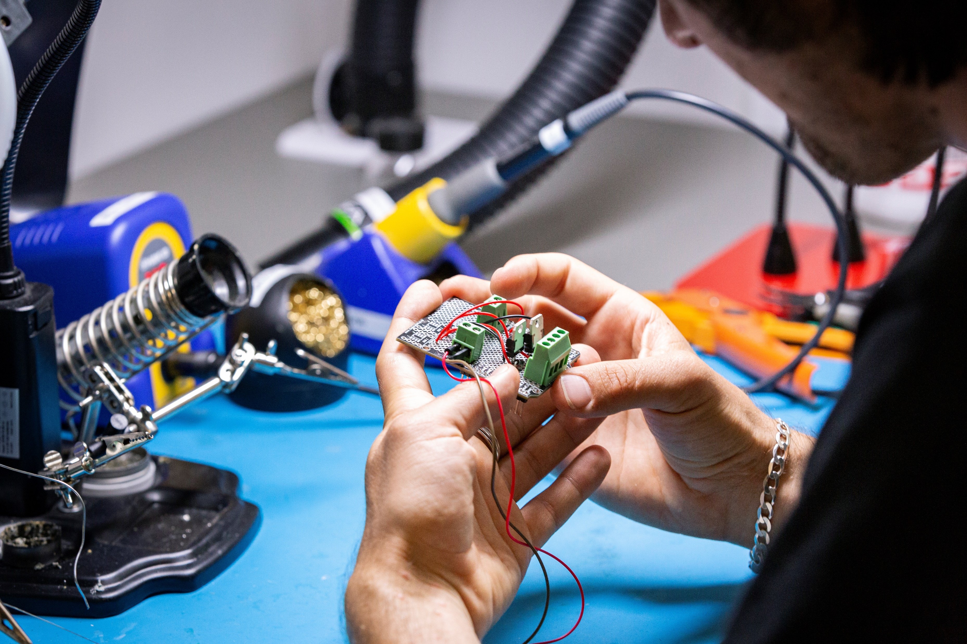
Tip 1: Images
Question time
Which image below is the original and which is compressed?
Images tend to be responsible for the largest over-the-wire transfer rates. So doing all you can to reduce them, their size, and loading will be beneficial for sustainability!
What you can do:
Assess the need for images, remove any that you can.
Compress those you can’t remove. This reduces the size but not the quality of the image.
There are a range of free image compression sites available online.
Compressed
ORIGINAL

Slide 16
10 tips for more sustainable elearning content
Tip 1:
Images
Tip 2: Language
Carbon counter

